Slide 1


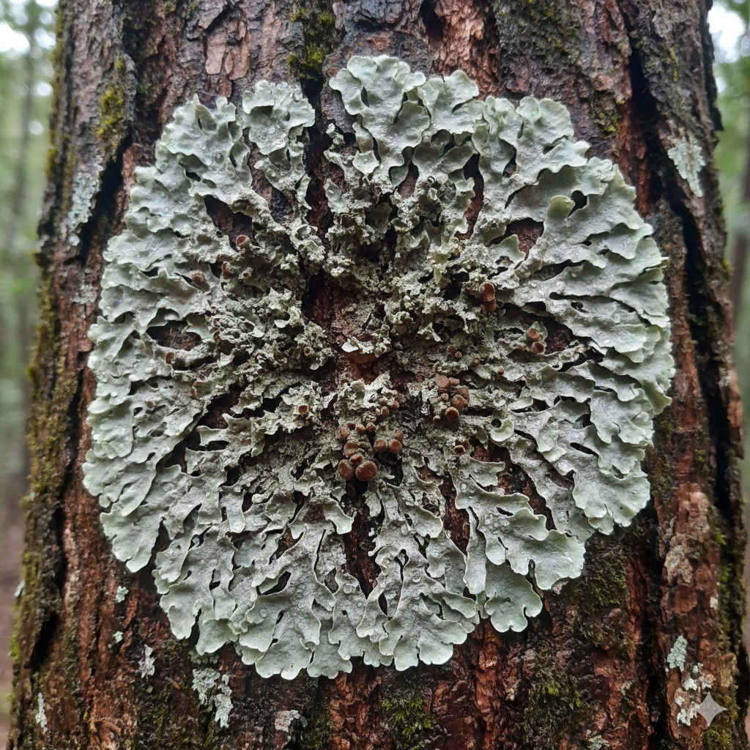


PRELIMINARY SCREENING OF ANTIOXIDANT AND PHYTOTOXIC PROPERTIES OF Dirinaria LICHEN SPECIES
MINI-PROJECT PROPOSAL
Name : H.G.D. Yasodini
Reg. No : 20APP4539
Supervisor : Prof. R.G. Udeni Jayalal
Co-Supervisor : Dr. H. Sasimali M. soysa

Slide 2
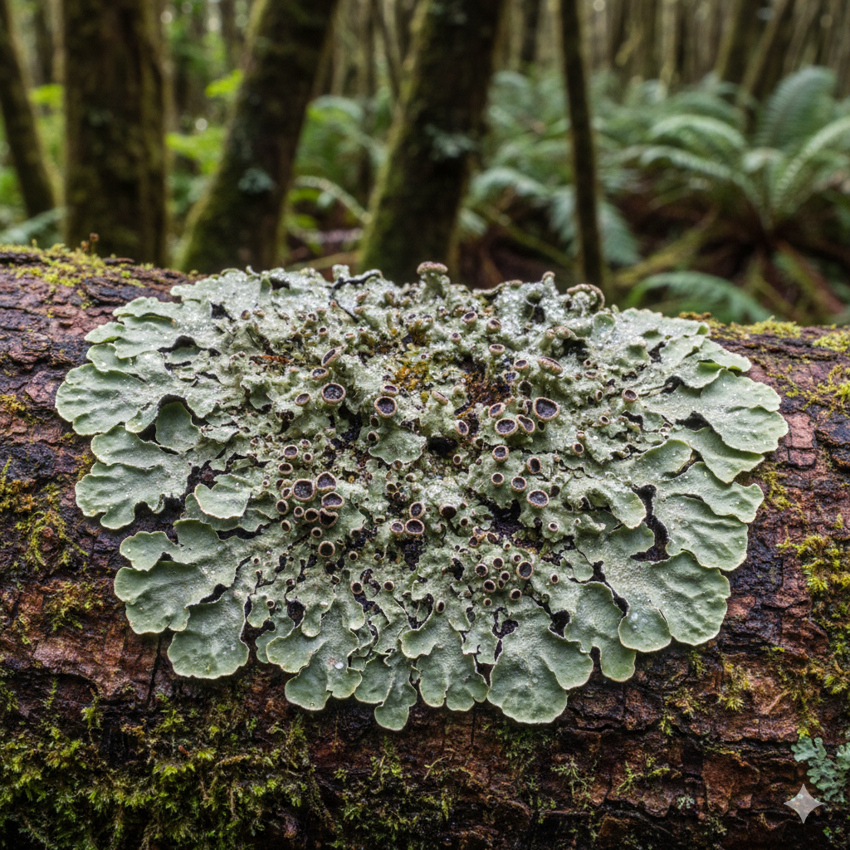
CONTENT
Introduction
Objectives
Literature Review
Methodology
Expected Outcomes
Timeline
References
02

Slide 3
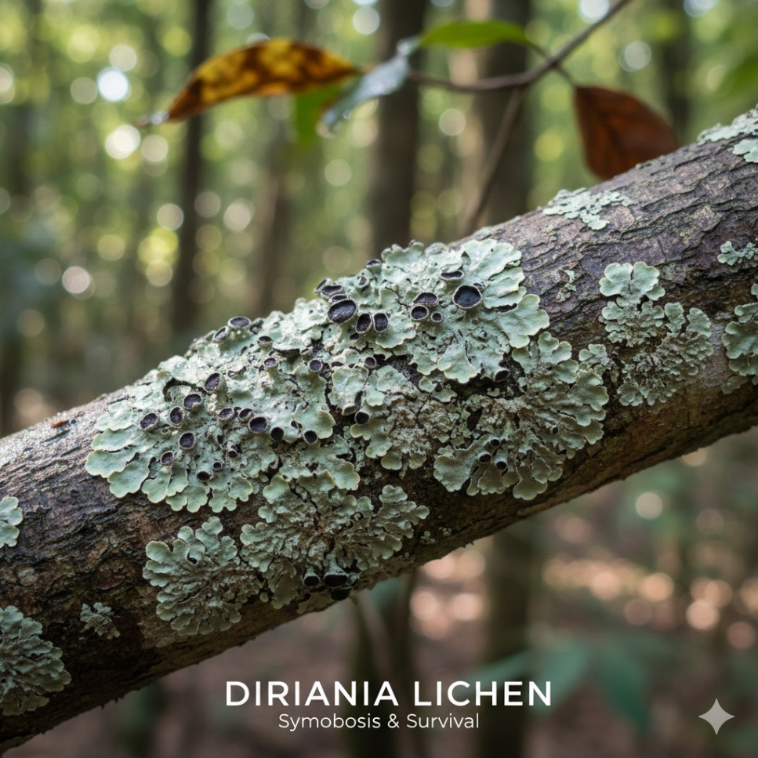


INTRODUCTION
Lichens are symbiotic organisms that produce biologically active secondary metabolites.
Dirinaria Lichen species are common in Sri Lanka but are not well studied.
They show antioxidant activity and phytotoxic effects on seed germination.
Screening these properties helps evaluate their biological potential and applications.
03

Slide 4
OBJECTIVES
General Objectives
Specific Objectives
To evaluate the antioxidant and phytotoxic activities of methanolic extracts of selected Dirinaria lichen species
To determine the antioxidant activity using the DPPH radical scavenging assay
To evaluate phytotoxic effects using a seed germination assay
To compare biological activities among five Dirinaria species (A–E)
04

Slide 5
LITERATURE REVIEW
Lichens are rich in secondary metabolites with reported antioxidant and biological activities.[1]
Dirinaria applanata and Dirinaria aegialita have shown significant in-vitro antioxidant activity using the DPPH assay.[2][3]
Lichen extracts have demonstrated phytotoxic effects by inhibiting seed germination and early seedling development. [4]
Methanol is commonly used as an extraction solvent for antioxidant and phytotoxicity studies. [2][4]
Comparative studies on multiple Dirinaria species, especially from Sri Lanka, remain limited, justifying preliminary screening. [2][3][4]
05

Slide 6

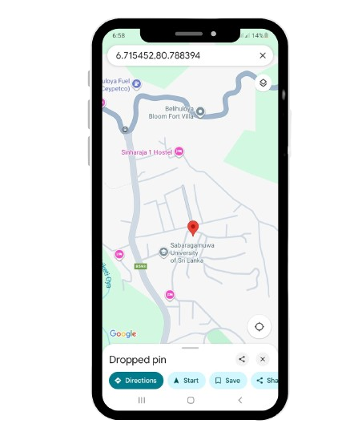
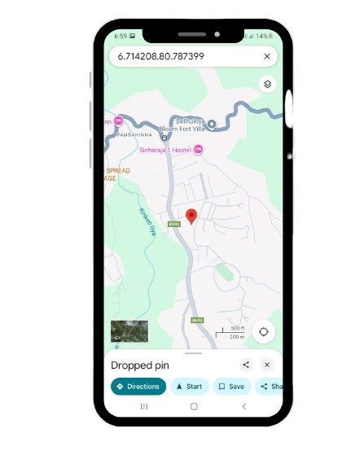
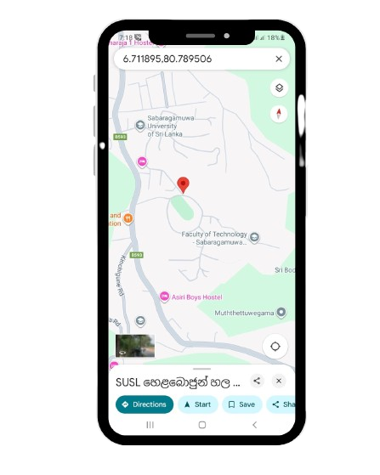
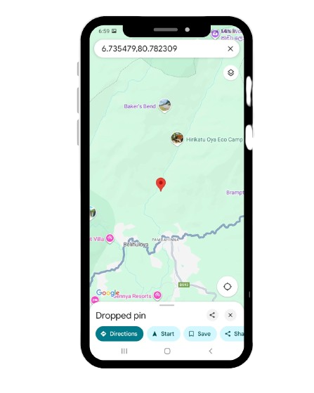

METHODOLOGY
Sample Preparation
Collect Dirinaria Lichens
Sample Collection Locations
Inside Sabaragamuwa University of Sri Lanka
Near Hirikatuoya
06

Slide 7
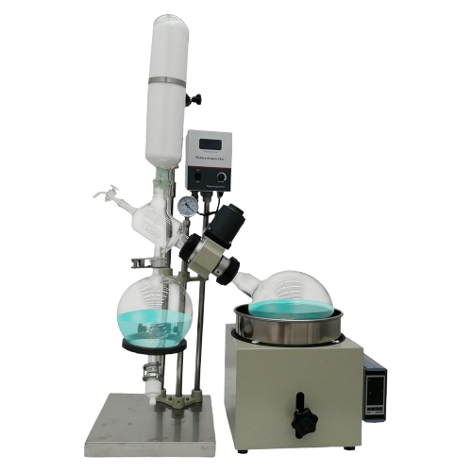
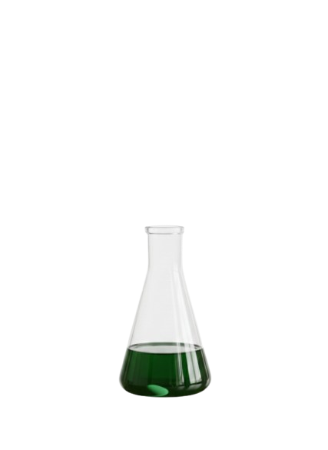
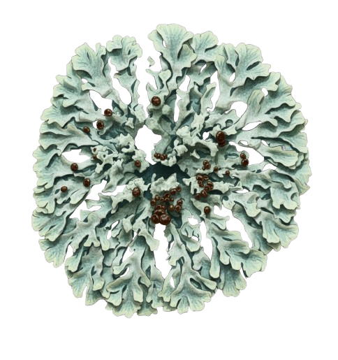
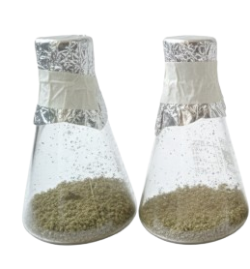
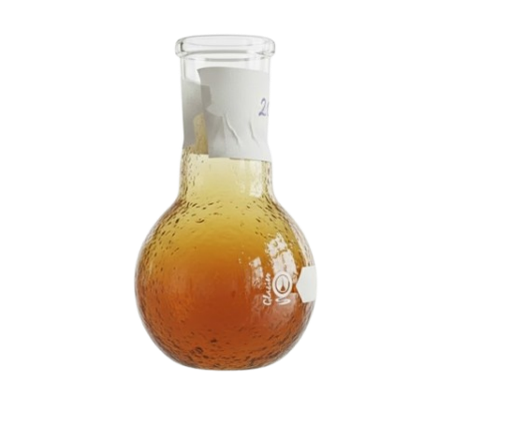
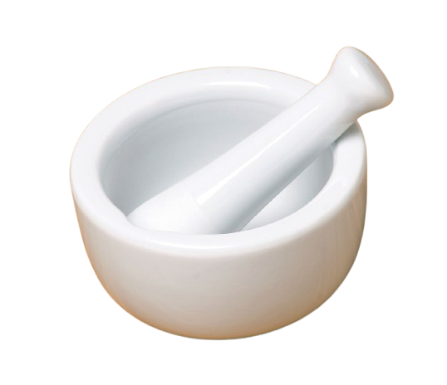
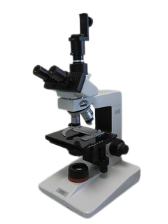
METHODOLOGY
Sample Preparation
Methanolic extract
Rotary evaporator
Collect Dirinaria Lichens
Separates lichen species
A
D
E
C
B
Sample maceration
Clean and dry the
lichens
Crude methanol extract
DPPH Radical Scavenging Assay
Seed germination test
Samples are grind
07

Slide 8

METHODOLOGY
Prepare DPPH solution
Prepare extract concentration series
Mix extract + DPPH
Antioxidant Activity
DPPH Radical Scavenging Assay
Incubate 30 min (dark)
Measure absorbance at 517 nm
Calculate % inhibition
08

Slide 9
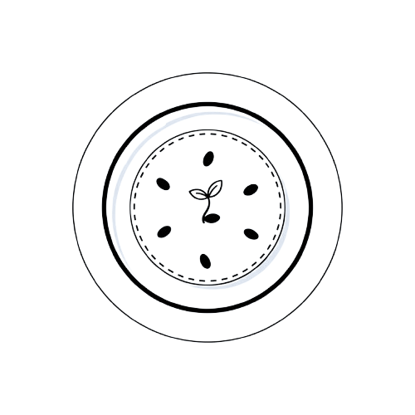
METHODOLOGY
Place the filter paper in the Petri dishes
Add lichen extract
Allow paper to air-dry for 15 minutes
Phytotoxic Effect
Seed Germination Test
Add distilled water
Place the seeds on the filter paper
Place the plates in the dark
Record the germination percentage and growth
09

Slide 10
EXPECTED OUTCOMES
Identification of antioxidant activity in Dirinaria lichen extracts
Observation of concentration-dependent inhibition in seed germination
Comparison of biological activities among five lichen species
Generation of preliminary data for future advanced studies
10

Slide 11
TIMELINE
Activity | Weeks
 | 01 | 02 | 03 | 04 | 05 | 06 | 07 | 08 | 09 | 10 | 11 | 12 | 13 | 14
Literature Review
Sample collection
Clean and dry
Extraction and crude preparation
DPPH assay
Seed germination test
Data analysis and report writing
11

Slide 12
REFERENCES
[1] | P. Khandel, R. K. Yadaw, D. K. Soni, L. Kanwar, and S. K. Shahi, “Biogenesis of metal nanoparticles and their pharmacological applications: present status and application prospects,” Journal of Nanostructure in Chemistry, vol. 8, no. 3, pp. 217–254, Jul. 2018, doi: https://pdfs.semanticscholar.org/6adf/2791a8dcecc46f5861923b23ad6297544807.pdf .
[2] | T. P. Kekuda, R. Dhanya, R. Dhatri, C. M. Sunita, R. Onkarappa, and K. S. Vinayaka,“Radical scavenging, antimicrobial and insecticidal efficacy of Parmotrema cristiferum and Dirinaria applanata,”Science, Technology and Arts Research Journal, vol. 4, no. 1, pp. 95–102, 2015.doi: 10.4314/star.v4i1.16Available: https://doi.org/10.4314/star.v4i1.16 .
[3] | S. Pradhan, D. K. Upreti, R. K. Meher, and K. B. Satapathy,“Antimicrobial, anticancer, and antioxidant potential of two dominant macro-lichen Dirinaria aegialita and Parmotrema praesorediosum collected from Similipal Biosphere Reserve of Odisha, India,”Journal of Applied Biology and Biotechnology, vol. 10, no. 6, pp. 34–43, 2022.doi: 10.7324/JABB.2022.100604Available: https://doi.org/10.7324/JABB.2022.100604 .
[4] | Ö. Bingöl, A. Battal, E. Erez, and A. Aslan,“Investigation of the allelopathic effects of lyophilized ethanol extract of Xanthoparmelia somloensis (Gyelnik) Hale lichen on tomato plant,”Anatolian Journal of Botany, vol. 6, no. 1, pp. 39–43, 2022.doi: 10.30616/ajb.1079286Available: https://doi.org/10.30616/ajb.1079286 .
12

Slide 13


THANK YOU

